Slide 1

Medaboost: An Improved Ensemble Learning Algorithm in Classification with Multiple Annotations
Yilin Dong
Advisor: Joyce Ho

Slide 2

Classification Problems
Features
Labels
Age | Blood Pressure | Heart Rate
20 | 90 | 80
Sample No. | Age | Blood Pressure | Heart Rate | Label
1 |  |  |  | Has certain disease
2 |  |  |  | No certain disease
…… |  |  |  | ……
Build a model that can correctly label new samples, based on training data that contains a set of labeled samples with their features.
Model
Model learns from training set
Model
Predicted Label
Has certain disease/No certain disease

Slide 3
Limit of Classification Algorithms
Difficult to collect ideal labels
Commonly used method:
Crowdsourcing
A group of people can annotate the same samples
Benefit: Low cost
Problem:
Inaccurate
Not applicable in common classification algorithms
Theory
Single and correct labels
Reality
Many unstructured data
High cost to label data

Slide 4

Problem Statement
Construct a supervised classification model when there are multiple annotations for the same sample.
Features
Multiple Annotations
Sample No. | Age | Blood Pressure | Heart Rate | Annotator 1 | Annotator 2
1 |  |  |  | Has disease | Has disease
2 |  |  |  | No disease | Has disease
…… |  |  |  | …… | ……

Slide 5

Notations
Features
Each sample i has features X_{i}.
i = {1, 2, …, n}
Annotations
Each annotator: a_{k}.
k = {1, 2, …, M}
Give out annotation y^{ak}_{xi} to sample i.
True labels
Z_{xi}= {-1, 1}
y^{ak}_{xi} = {-1, 1}

Slide 6
Truth Inference
Problem: Classification models cannot process multiple annotations
Solution: Use truth inference to determine an estimated truth from multiple annotations.
Sample i | Annotator a₁ | Annotator a₂ | Annotator a₃ | ……
1 | 1 | 1 | -1
2 | 1 | -1 | -1
……
Estimated Labels
1
1

Slide 7
Truth Inference
New problem:
Single estimated labels from truth inference are not 100% accurate.

Slide 8
Medaboost
Problem:
Inaccurate labels in training dataset leads to biased classification model
Solution:
Develop a new model, Medaboost, to prevent the model from overfitting toward incorrect labels
Take the annotation’s disagreements into account

Slide 9
Solution Overview
Inputs
Features
Multiple Annotations
Truth Inference
Estimated
labels
Medaboost
Outputs
Predict model
Notes:
Consider talking about:
Machine learning tasks

Slide 10
Truth Inference – Majority Voting
Each annotation counts as one vote.
Choose the most voted label.
Annotator a₁ | Annotator a₂ | Annotator a₃ | Annotator a₄ | Annotator a₅
1 | 1 | -1 | 1 | 1
1 | -1 | -1 | -1 | -1
……
Inferred Truth
1
-1

Slide 11
Truth Inference – Weighted Majority
Based on MV, vote is multiplied by annotators’ weights. Initial weights are 1.
When a mistake is made, update weight as weight*β (β <1)
Annotator a₁ | Annotator a₂ | Annotator a₃ | Annotator a₄ | Annotator a₅
1 | 1 | -1 | 1 | 1
1 | -1 | -1 | -1 | -1
……
Annotator | Weight
1 | 1
2 | 1
3 | 1
4 | 1
5 | 1
Annotator | Weight
1 | 1
2 | 1
3 | β
4 | 1
5 | 1
Annotator | Weight
1 | β
2 | 1
3 | β
4 | 1
5 | 1
E.g. Sample 2:
3+β votes for label -1; 1 vote for label 1. Choose label -1

Slide 12
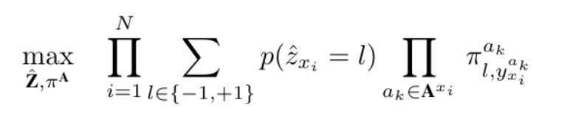
Truth Inference –Expectation-Maximization
Confusion Matrix for each annotator a_{k}:
π^{ak} = ,
where α=p(y^{ak}_{xi}= 1|z_{xi}= 1), β=p(y^{ak}_{xi}=−1|z_{xi}=−1) Use maximum likelihood estimation to optimize estimated truth and confusion matrixs:

Slide 13
Model Baseline: Adaboost
Ensemble learning algorithm that combines “weak” classifiers to construct “strong” classifiers
Initial weights are 1 for all samples
Begin iteration:
Select a weak classifier which produces hypothesis that minimizes the total weighted error ε
Determine the weight for this weak classifier based on ε
Update the weight for each sample: the misclassified sample gets more weight
Final classifier combines previous weak classifiers and their weights

Slide 14
Limit of Adaboost
Problem:
Sensitive to inaccurate labels.
Inaccurately minimizing errors
E.g. a positive sample is labelled as negative.
Penalty for “misclassifying” this sample (label it positive) is large
Deviate from the ideal model

Slide 15
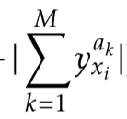
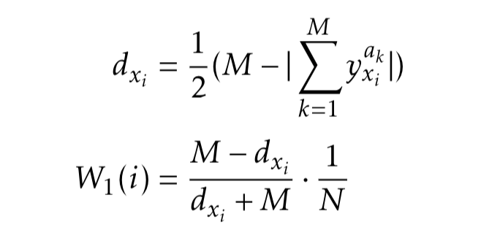
Our Model: Medaboost
Rationale: High disagreements in multiple annotations mean this sample is hard to classify
Solution: Change the initial weight in Adaboost
More disagreements, less weight
d_{xi} is the disagreement factor for sample i
E.g. M = 10, 6 “1” labels and 4 “-1” labels
= 2, d_{xi} = 4.
W₁(i) = 6/14 * Normalization factor
1 | 1 | -1 | -1 | -1 | -1 | 1 | 1 | 1 | 1

Slide 16
Dataset (1) -- Synthetic Dataset
10 features
Ground Truth
Samples
Multiple Annotations
10 annotators.
Numeric values: doubles
10,000 samples
{-1, 1}
Ratio:8:2

Slide 17
Dataset (1) -- Synthetic Dataset
10 features and ground truth
Follow Gaussian distribution
Mean (Center of cluster):
Label -1: (1.5, 1.5, …, 1.5)
Label 1: (5, 5, …, 5)
Standard deviation: both 2.5
10 annotators
Calculate Euclidean Distance
More disagreements in the intersection
e.g.
1 | 1 | 1 | 1 | 1 | 1 | 1 | -1 | 1 | 1
-1 | -1 | 1 | -1 | 1 | -1 | -1 | -1 | -1 | -1
-1 | 1 | 1 | -1 | 1 | -1 | 1 | -1 | -1 | -1
-1 | -1 | -1 | -1 | -1 | -1 | -1 | -1 | -1 | -1

Slide 18
Dataset (1) -- Experiment setting
For each distribution region, we changed the possibility of giving out the two labels for each annotators.
10 datasets with different mean reliability of annotators
Ranged from 74% to 91%.

Slide 19
Dataset (2) --MIMIC-III Dataset
89 features
Demographics
Diagnosis
Measurements
Ground Truth
-1: No Pressure Ulcers
1: Has Pressure Ulcers
Roughly 8:2
Samples
3589 samples
Multiple Annotations
Simulate nurses’ Annotations
- Generate Beta Distribution
- Adjust mean reliability and standard deviation

Slide 20
Dataset (2) -- Experiment setting
We change three parameters to construct datasets:
M = 3; M = 5.
4 reliability mean to generate beta distribution
0.5, 0.57, 0.64, 0.7
Repeat two times
2 reliability standard deviation (S.D)
2*4*2*2=32 datasets

Slide 21
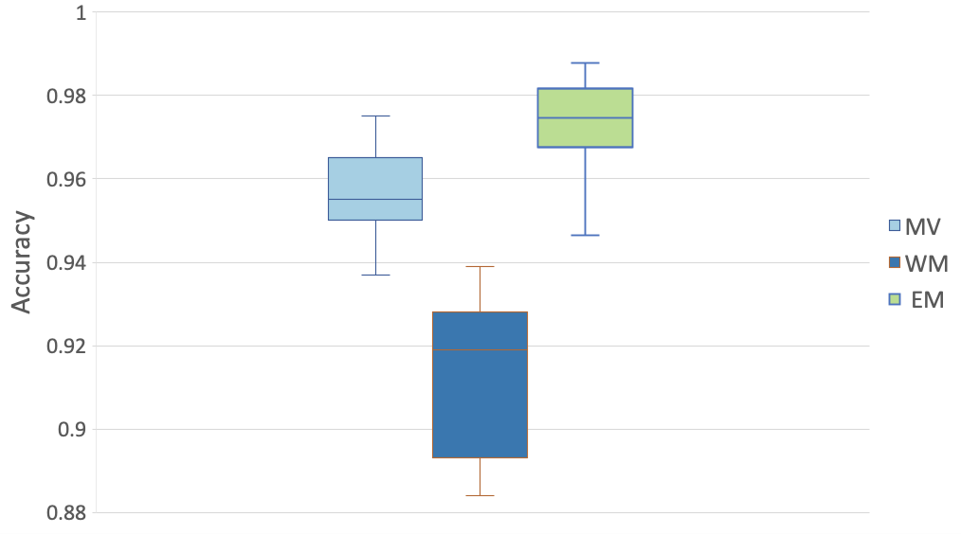
Result: Truth Inference
Synthetic dataset
EM has the highest accuracy
WM performs the worst

Slide 22
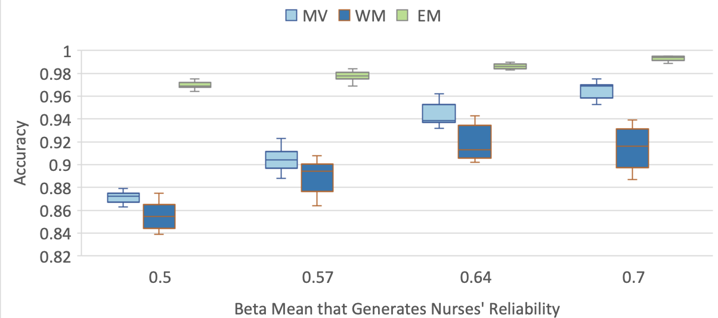
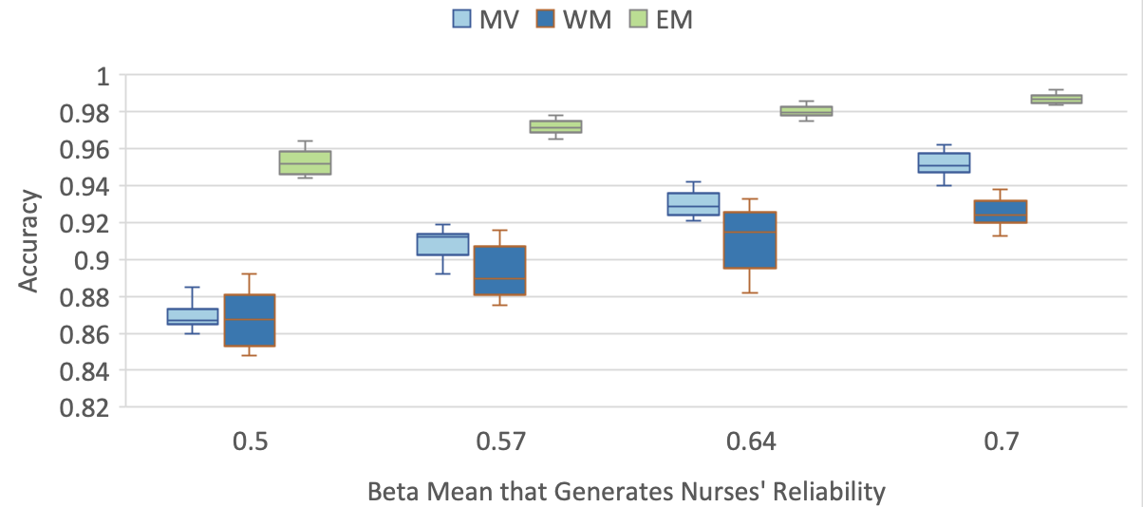
Result: Truth Inference
MIMIC-III Dataset
5 annotators
3 annotators

Slide 23
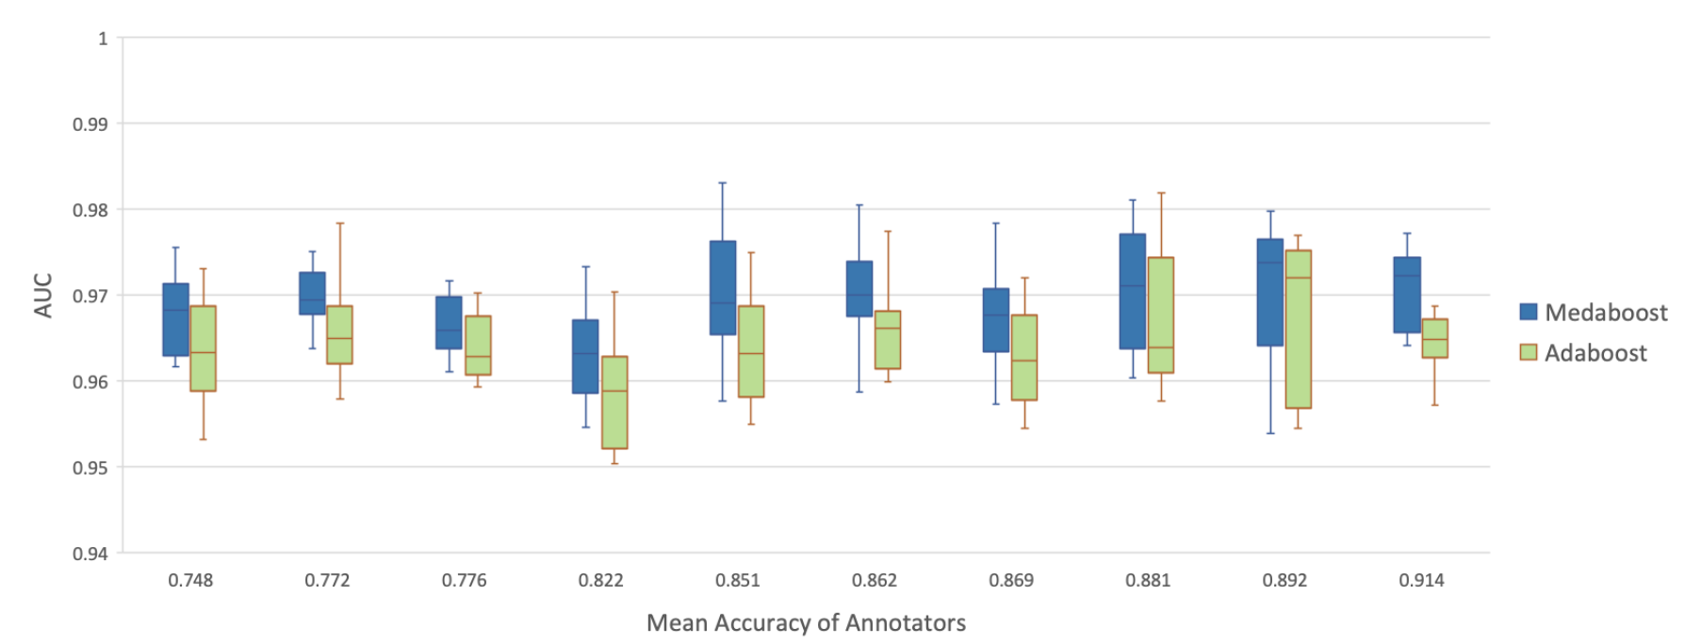
Result: Medaboost -- Synthetic data
Median AUC of Medaboost is higher than that of Adaboost
No clear trend of the influence of annotators’ mean accuracy

Slide 24
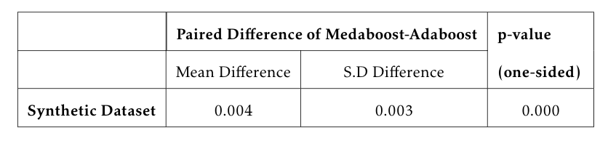
Result: Medaboost -- Synthetic data
Paired t-test:
P-value < 0.05
Medaboost outperforms Adaboost

Slide 25
Result: Medaboost -- MIMIC-III Dataset
Median AUC of Medaboost is higher than that of Adaboost
No clear trend of the influence of annotators’ mean accuracy

Slide 26
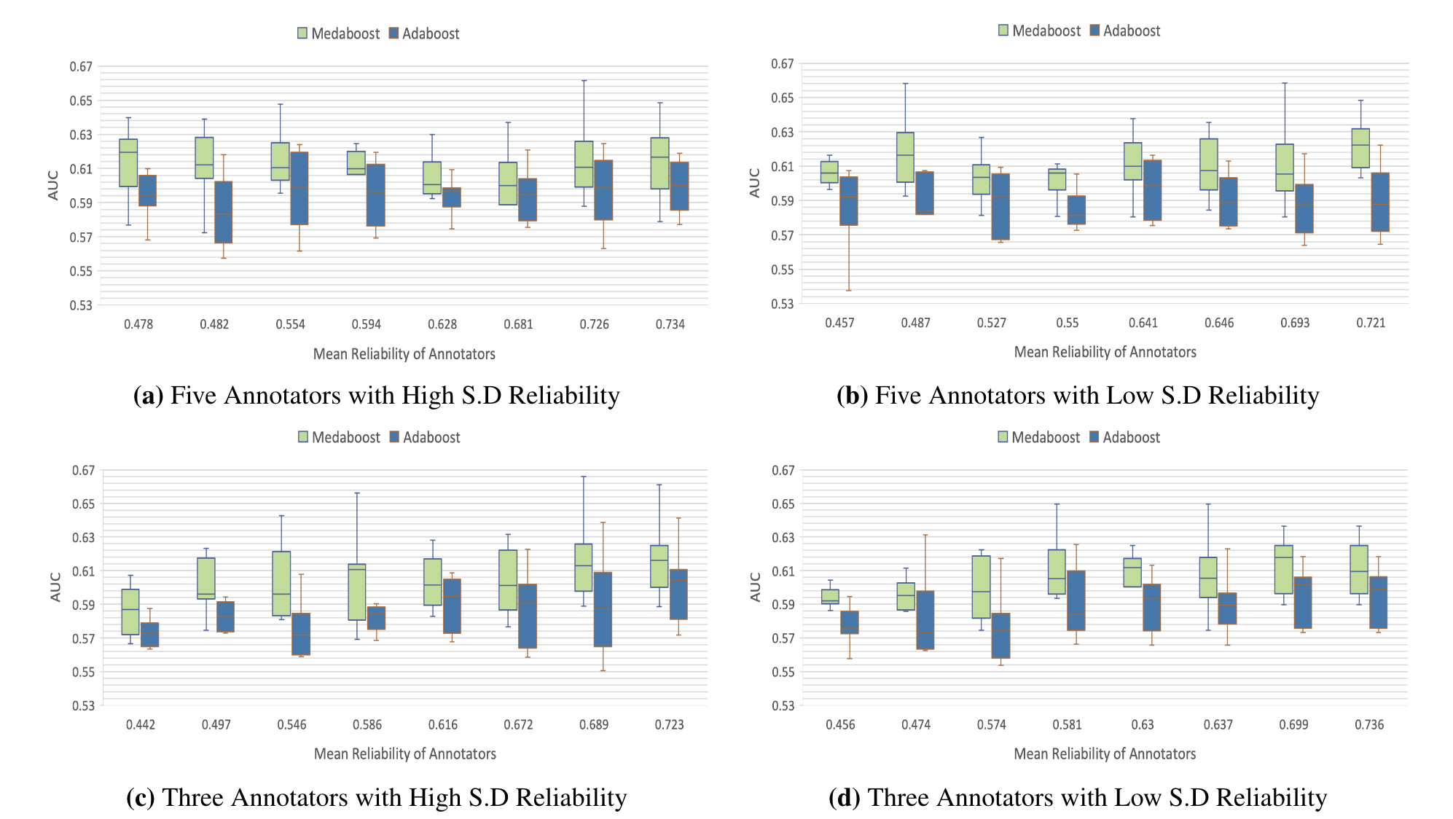
Median AUC for dataset with 5 annotators are slightly higher than that with 3.
E.g. (a) and (c): range for 5: 0.600 and 0.61; range for 3: 0.582 and 0.616.

Slide 27
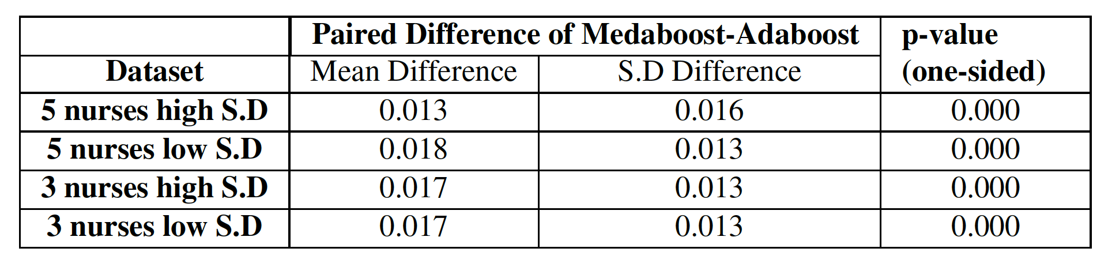
Result: Medaboost -- MIMIC-III Dataset
Paired t-test: Medaboost outperforms Adaboost

Slide 28
Conclusion
Contribution:
Build Medaboost that improve Adaboost when multiple annotations exist
EM performs the best over MV and WM
Limitation:
Both dataset have synthetic part. Need to experiment on real data.
Future Work:
AUC still low (around 60% in MIMIC-III dataset)

